Slide 1




SAFESTEP
A STICK FOR A BLIND

Slide 2

Problem Statement
Physical Safety
Independence
1
2
Navigating busy streets, avoiding obstacles, and recognizing potential hazards are constant concerns.
Limited ability to perform everyday tasks like shopping, cooking, or traveling independently.
3
Social Interaction
Difficulty recognizing faces and body language, leading to social isolation and reduced communication.

Slide 3

SOLUTION
SAFESTEP
1
Object Detection
We have developed a wearable object detection system that utilizes a combination of advanced AI and sensor technology.
2
Audio Feedback
3
Haptic Feedback

Slide 4




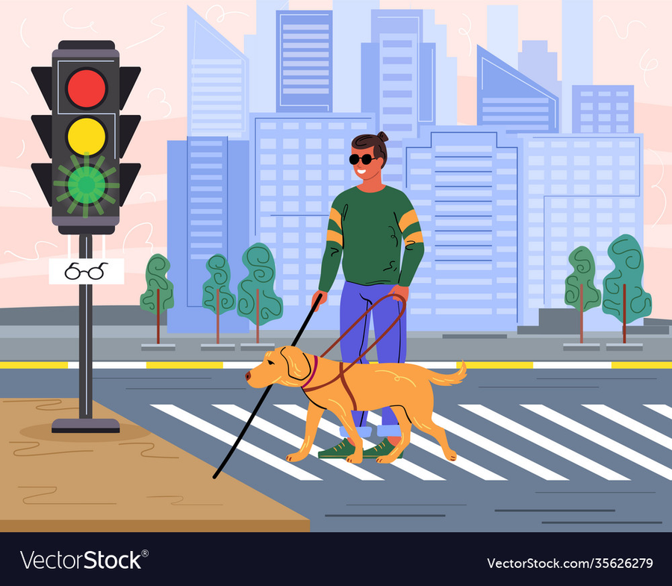


Features & Benefits
Real-Time Object Detection
Versatile Object Recognition
Customizable Settings

Slide 5



Technical Details
USING MULTIPLE PYTHON LIBRARIES SUCH AS CV2, PYTTSX3 & numpy.
RASPERRY PIE WITH INTEGRATED CAMERA AND SENSOR CAN BE USED TO CONVERT THE MODEL INTO SAFESTEP STICK.
CREATE A WEBSITE OR APP FOR THE FUNCTIONALITY AS FOR NOW WE ARE USING THE PROTOTYPE AS A LOCAL HOST ON OUR LAPTOP .

Slide 6










Market Potential
Global Blind Population
According to the World Health Organization, over 2.2 billion people have a visual impairment, with over 39 million blind.
Increasing Demand
The growing awareness of assistive technology and the desire for greater independence are driving market demand.
The market for assistive technology for blind people is vast and rapidly growing.
Government Support
Governments around the world are investing in assistive technology to promote inclusivity and improve the lives of disabled individuals.

Slide 7

A
ChatGpt- Error correction
GitHub Modules
B
Resource
Page
C
DroidCam-Phone camera connectivity
Python Libraries
D
E
VS Code

Slide 8
Thank you!
PRANAV KARRA 23BCE10775
RAHUL KHATWANI 23BCE10658
SOMYA PANIYA 23BAI10140
LAKSHYA HIRANI 23BAI10031
SHLOK RAJESH DHANOKAR 23BAI10289

